Slide 1
Own rule to Organize personal data
By: mengkorng ly
Class: 2024
Web: C

Slide 2
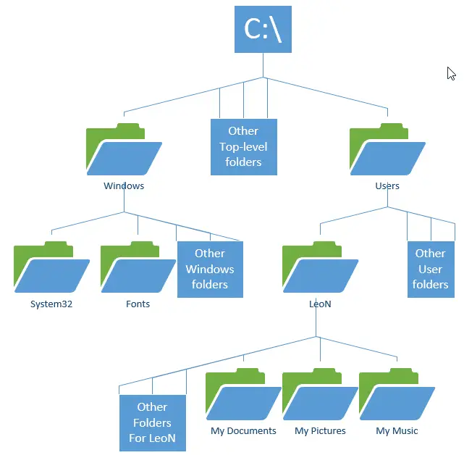



Subject
1.How to organize personal data
2.How to organize folders structure
3.Rules to keep it clean

Slide 3


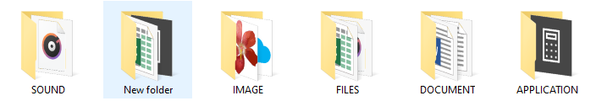
QUESTION
What is the personal data

Slide 4

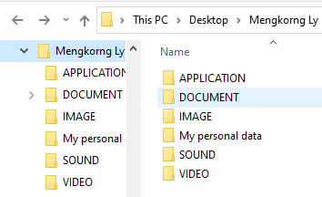
Content
Personal data is a information that relates to an identified or identifiable individual.
Types of personal data

Slide 5
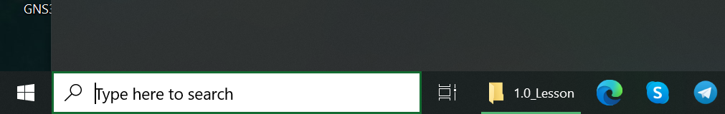

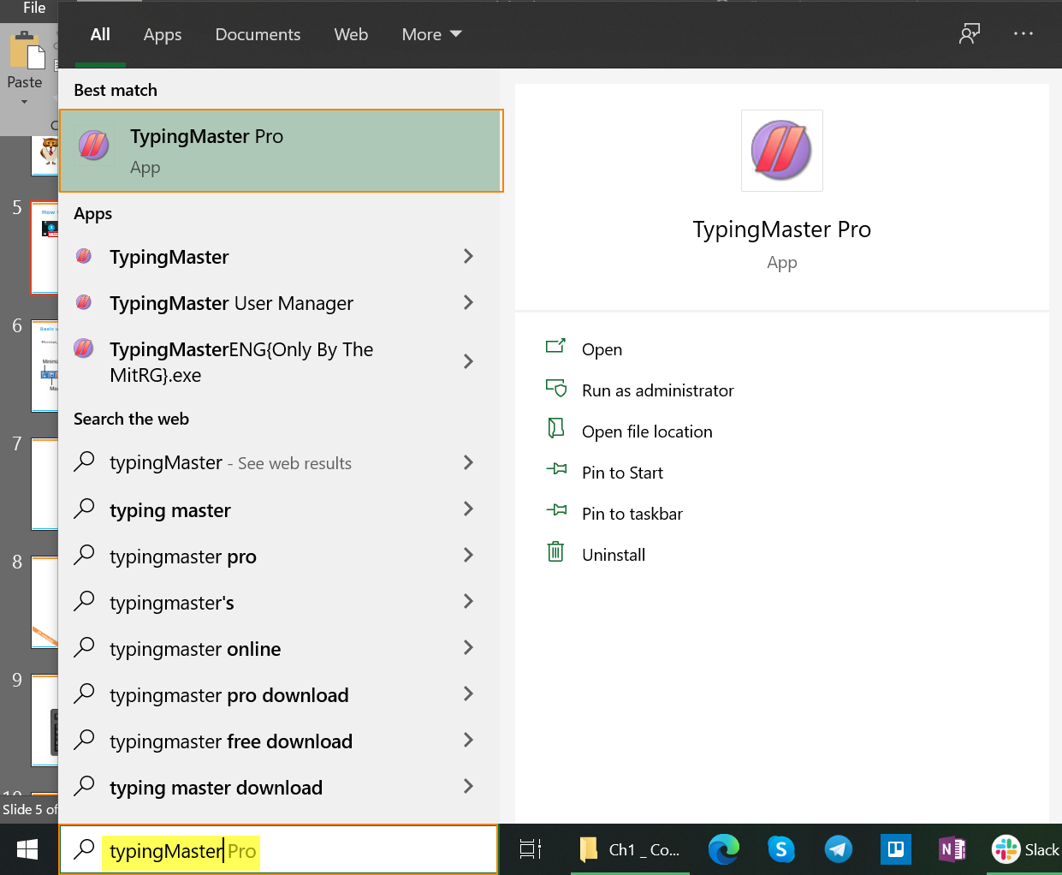
How to open “Typing Master”
1
1. Click on Search Box
2. Type word “TypingMaster” inside the Search Box. Click on “TypingMaster Pro App” to open it.
2

Slide 6


Question
https://www.typing.com/student/lessons

Slide 7
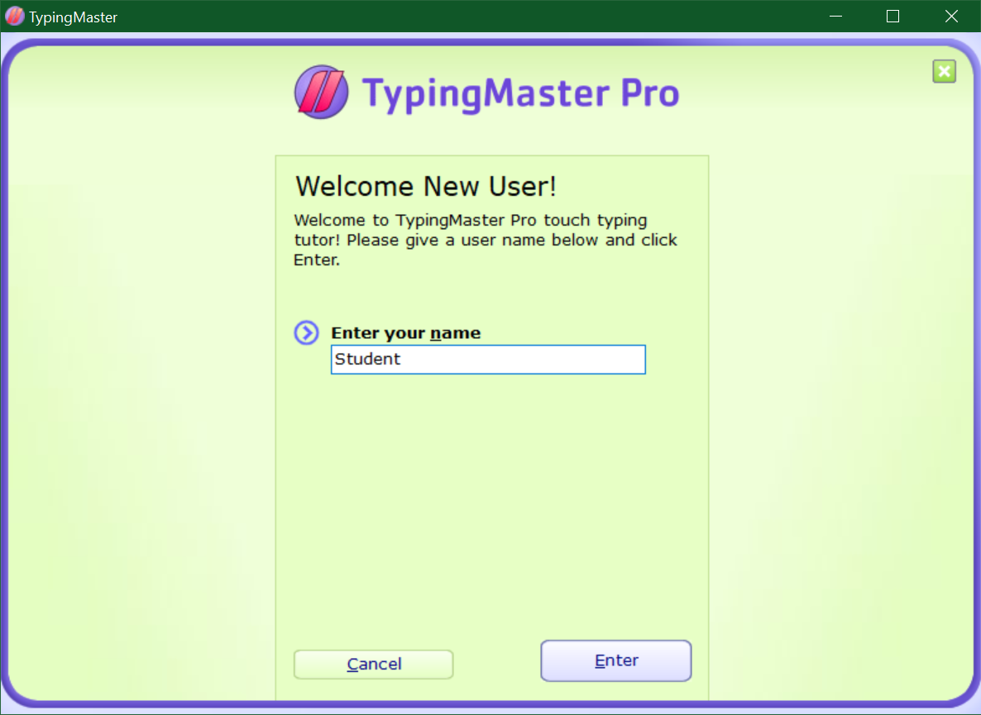
How to open “Typing Master”
3. Put your name,
then click Enter.
3

Slide 8

Demo
Teacher demo how to:
Open Typing Master application
Using mouse (open application, minimize, maximize,..)
Notes:
Open any browser to show them

Slide 9
Activity
1). Turn on your computer
2). Search “Typing Master” on search box
3). Pin “Typing Master” to Start Menu
4). Click on “Typing Master” icon to open it
5). Click minimize “Typing Master”
6). Click Maximize
7). Close Typing master
Students follow with instruction from Teacher one by one
20 minutes
Notes:
Let them do it

Slide 10
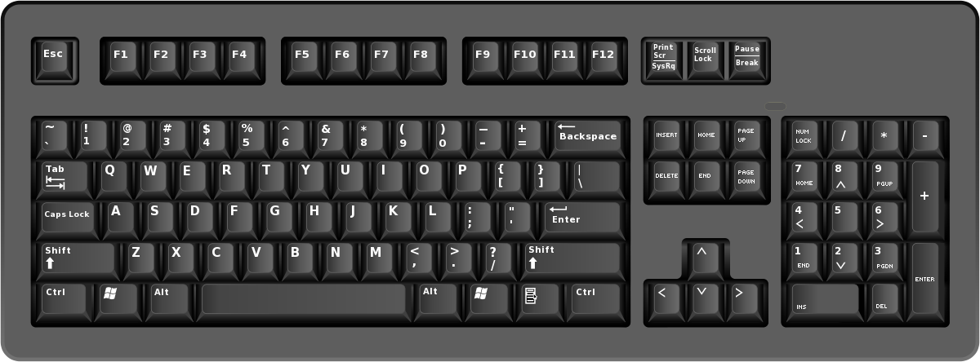
Introduction to Keyboard
Desktop keyboard
The standard US Qwerty keyboard has 101, 104 or 107 keys

Slide 11
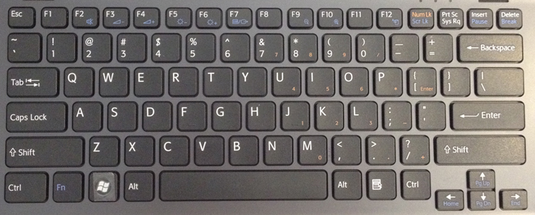
Introduction to Keyboard
Laptop keyboard
Depend on type of laptops but at least 84 keys

Slide 12
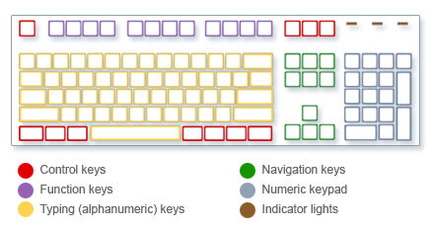
How the keys are organized

Slide 13
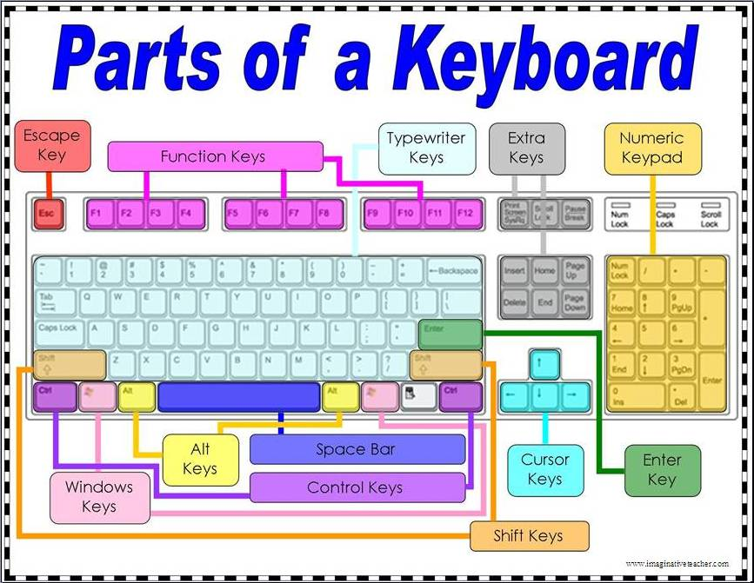

Slide 14
How the keys are organized
The keys on your keyboard can be divided into several groups based on function:
Typing (alphanumeric) keys: These keys include the same letter, number, punctuation, and symbol keys found on a traditional typewriter.
Control keys: These keys are used alone or in combination with other keys to perform certain actions. The most frequently used control keys are Ctrl, Alt, the Windows logo key Picture of the Windows logo key, and Esc.

Slide 15
How the keys are organized
Function keys: The function keys are used to perform specific tasks. They are labeled as F1, F2, F3, and so on, up to F12. The functionality of these keys differs from program to program.
Navigation keys: These keys are used for moving around in documents or webpages and editing text. They include the arrow keys, Home, End, Page Up, Page Down, Delete, and Insert.
Numeric keypad: The numeric keypad is handy for entering numbers quickly. The keys are grouped together in a block like a conventional calculator or adding machine.

Slide 16

Login to Typing Master
Teacher show how to login to Typing Master to Students.

Slide 17

How to put your hand
In the basic position, your fingers rest on the middle row of the keyboard – also call the “home row”.

Slide 18
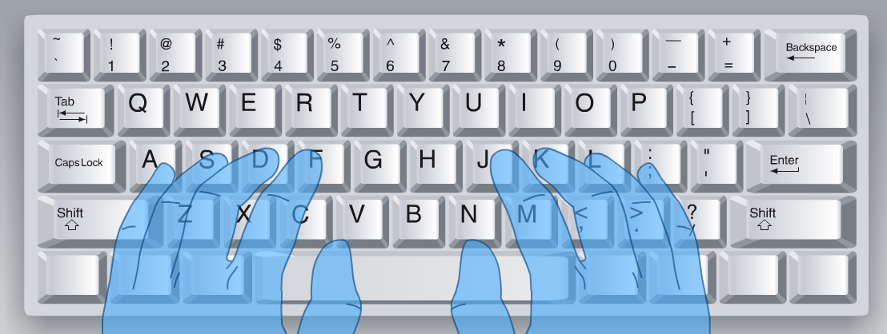
How to put your hand
Put your left hand fingers on key A S D F
Put your right hand finger on key J K L ;
Let the thumbs rest lightly on the space bar

